Slide 1
BFS graph traversal using cuda
Hardeep Singh

Slide 2
Contents
Introduction
Background information
Theoretical framework
Implementation
Experiments and results
Conclusion
References

Slide 3
Introduction
Graph is a collection of vertices and these vertices have connection through edges.
Graphs are represented through G (V, E).
FIG 1. Directed graph
Where V is the set of vertices or nodes and E is the set of edges.
0
1
2
4
3

Slide 4
What is graph traversal?
In computer science, graph traversal refers to the process of visiting each vertex in a graph.
Graph traversal are classified by the order in which the vertices are visited.
There are two types of graph traversal techniques:-
Breadth first search
Depth first search

Slide 5
What is breadth first search?
Breadth first search is the technique for traversing a finite graph.
BFS visits adjacent vertices before visiting the child vertices.
The cost from source node to all other nodes calculated in terms of number edges required to reach every other node in the given graph.
Applications of BFS:-
Finding shortest path between two vertices.
Testing a graph for bipartiteness.
Network analysis.
GPS navigation system.

Slide 6
How to store graph data?
1. Using adjacency matrix representation
It is basically a 2D array of size V*V, where V is the number of vertices.
0 1 2 3 4
0
1
2
3
4
Fig 2. Adjacency matrix representation
Space complexity = O( v² ), very sparse matrix, hard to fit, more copy overhead.
0 | 1 | 1 | 0 | 0
0 | 0 | 0 | 1 | 0
0 | 0 | 0 | 1 | 1
0 | 0 | 0 | 0 | 0
0 | 0 | 0 | 0 | 0

Slide 7
Continued….
Using Adjacency list representation:-
In this representation, an array of linked list is used and size of array is set equal to the number of nodes in graph.
0
1
2
3
4
Fig 3. Adjacency list representation
Space complexity :- O(V+E), Less copy overhead.
1
2
/
3
/
3
4
/

Slide 8
Continued….
3. Using compact-adjacency representation :-
It is required to use two different arrays to store graph data.
Vertices array :- Stores all the vertices of the graph.
Edges array:- Each entry in this array refers to a vertex in the vertex array.
Vertices array
Edges array
Fig 4. Compact-adjacency representation
Used to implement parallel algorithm in our paper.
0
1
2
3
4
1
2
3
3
4

Slide 9
Sequential Bfs algorithm
Sequential BFS uses queue data-structure to store vertices.
All the to-be-processed vertices are stored inside the queue and then algorithm dequeue them one-by-one.
Pseudocode:-
Initially set all nodes to not visited.
Create new queue and enqueue first node of the graph.
while( queue is not empty ) do
dequeue the first node
If the node not visited yet set visited = true for that node.
For ( enqueue all adjacent nodes of processed vertex.
Repeat until queue is empty.

Slide 10
What is level synchronization?
Instead of processing node 1 by 1, parallel BFS uses level synchronization.
In which all vertices in one level are traversed once.
E..g Level 1
Level 2
Level 3
Fig 5. showing levels of graph
One thread is assigned to each vertex.
0
1
2
3
4

Slide 11
Input arrays
There are 5 input arrays used for parallel algorithm:-
Vertices array = contains all vertices of the graph.
Edges array = contains nodes adjacent to the vertices in vertices array.
Frontier array = It is a Boolean array contains true value for every unprocessed nodes.
Visited array = It is also a Boolean array contains true value for all traversed nodes.
Cost array is an integer array contains number edges required for source vertex to Reach all other vertices

Slide 12
Parallel BFS algorithm
1. Begin
Initialize frontier and visited array as false.
Initialize cost array to ∞.
Frontier[S] true and cost[S] 0.
While Frontier[S] not empty do
2.For each vertex in parallel do (Kernel algorithm)
Compute adjacent number of vertices.
Allocate thread to every vertex present in the level.
Check if vertex is not visited yet.
Cost[V] Cost[V] + 1.
Store traversed vertex in visited array.
End for
End while

Slide 13
Algorithm explanation
In the given parallel breadth first search algorithm, for every iteration, each vertex Look for its value in frontier array.
If the value is true for that vertex, than the cost is updated to the cost array.
After updating cost, the vertex removed from the frontier array and added to the visited array.
Moreover, all the adjacent nodes to the recently traversed vertex added to the frontier array.
This process will repeated until frontier array is empty

Slide 14
Program execution flowchart
.
Load graph data
Define BFS kernel function
Allocate host and device memory and transfer data from host to device
Launch BFS kernel function
Transfer result from device to host and release host and device memories

Slide 15
System description
Software architecture
NVidia Nsight Eclipse edition 7.5
CUDA Toolkit 7.5
Hardware architecture
NVIDIA GeForce GTX 780
Intel CORE i5
Language used :- CUDA-C
Development environment
The BFS parallel algorithm is implemented by using NVIDIA Nsight development environment.
It is the platform for heterogeneous computing.
NVIDIA Nsight is a full featured IDE platform which provides all in one integrated environment to edit, build, debug CUDA-C, C++ and FORTRAN applications.

Slide 16
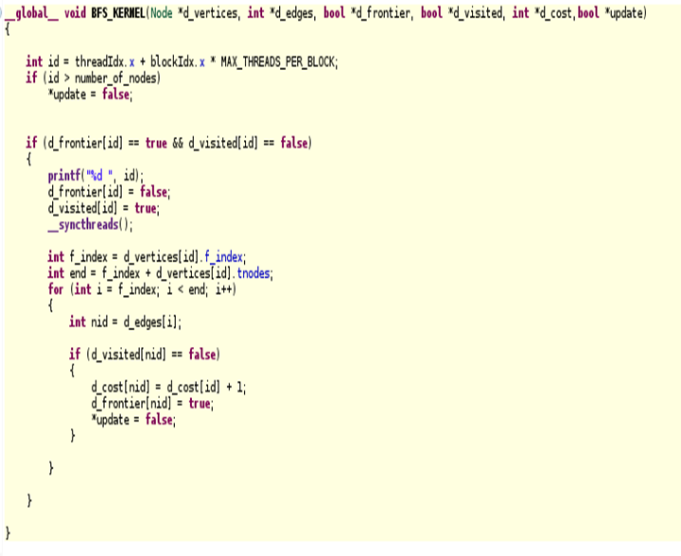
Kernel Code diagram
CUDA-C code for the kenel algorithm discussed above.
f_index :- It is the index of first adjacent node in array edges.
tnodes :- It is the number of adjacent nodes to a vertex.

Slide 17
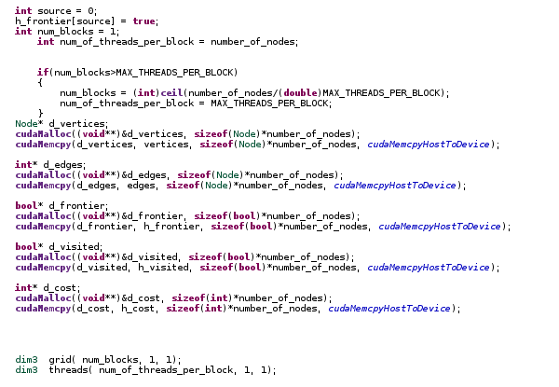
Transferring data from host to device memory
After allocating the device memory to all the arrays, data is transferred from host to device. Which is accomplished by calling CUDA API functions like cudaMemcpy.
The maximum threads per block can be 512.

Slide 18
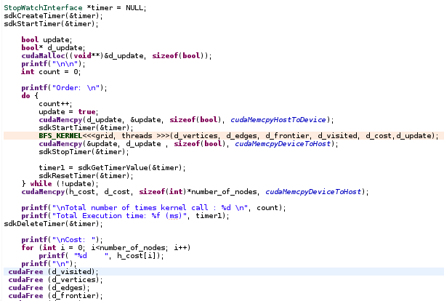
Kernel launch host code
We have defined variable to check the total execution time of the parallel program.
Moreover, we launch BFS_KERNEL and then copy cost array data from device memory to host memory.
The cost need to reach every vertex from source vertex is calculated.
At the end device memory used by the variables get free using API function cudaFree.

Slide 19
Experiment results
Experiment No. | Number of Graph nodes | GPU Execution time | CPU Execution time | Number of times kernel called | Speedup Factor
1. | 10 | 0.10500 ms | 1.3000 ms | 5 | 12.4x
2. | 22 | 0.10800 ms | 1.5300 ms | 7 | 14.1x
3. | 64 | 0.11000 ms | 2.7100 ms | 13 | 24.6x

Slide 20

Experiment 4.
This experiment is done by using the graph given in the Fig.1.
fig. 9 output screenshot from Nsight
The total number of times kernel called is 3.
The cost required to reach nodes 3 and 4 from source node is 2.
The nodes are traversed in the order 0 > 1 > 2 > 3 > 4

Slide 21
Conclusion
Experiment results shows that the computation speed of parallel algorithm on GPU is faster than the sequential BFS algorithm.
Moreover, it also demonstrates that the compact adjacency list graph representation data structure makes it possible for parallel algorithm traverse graph faster as compare to the queue and matrix adjacency data structure.
In addition, parallel approach to many other real world applications can make huge difference in term of computation speed using GPUs.
In future, Hierarchical queues can be used as graph representation data structure.

Slide 22
References
J.D Owens, D.Luebke, N.K Govindaraju, M.Harris, J.kruger, “A survey of general purpose computation on graphics hardware, “in Proc. Eurographics, state Art Rep, 2005, pp. 21-51.
Jun-Dong Cho, Salil Raje, and Majid Sarrafzadeh, “Fast approximation algorithms on maxcutm k-coloring and l-color ordering for ylsi applications,” IEEE transactions on Computers,1998.
David A.Bader and Kamnesh Madduri, “Designing multithreaded algorithms for breadth-first search and st-connectivity on MTA-2,” In ICPP,pages 523-530, 2006.
P.Harish and P.J Narayanan, Accelerating Large Graph Algorithms on the GPU using CUDA, “ in proc. HiPC, 2007, pp 197-208.
L. Luo, M. Wong, and W.-M. Hwu, An Effective GPU implementation of Breadth first search, 2010.

Slide 23
Questions?
.

